Slide 1


Smart India Hackathon 2019

Slide 2
MSME Development OrganiSation, Govt. of India, Ministry of MSME
TeaM - cardio coders
Dr. Akhilesh das gupta institute of technology and management, delhi

Slide 3

Forecasting
Using the dataset created, we will compare the given satellite images and apply simple subtraction of matrices to forecast Tsunami and the distance from the emergence points.
After processing and taking out the differences between the images, the coordinates (latitudes, longitudes) will be found out.
This data will be fed to firebase to predict the coordinates of possible Tsunami-prone areas.
Image Processing

Slide 4
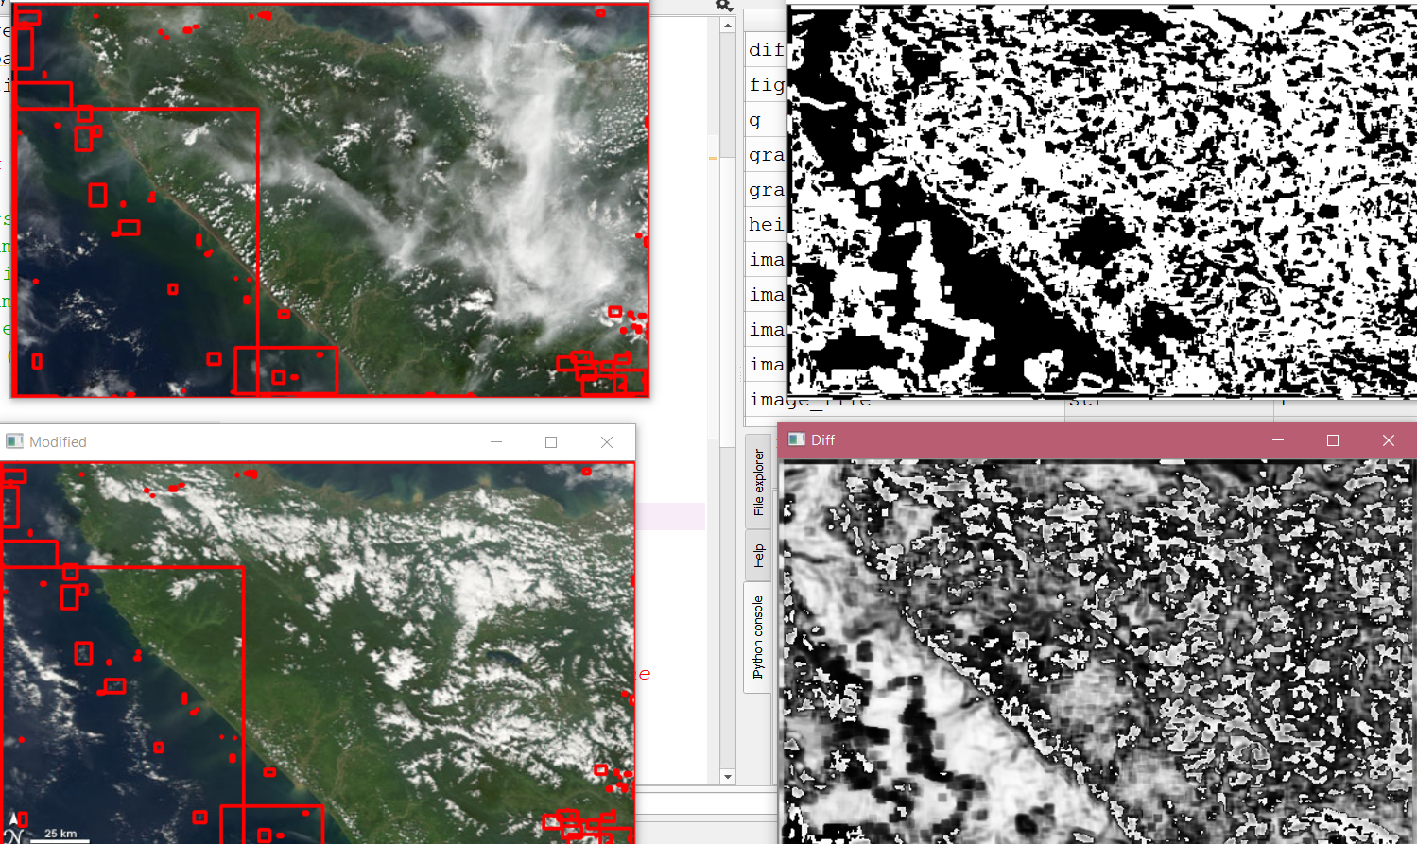

Slide 5
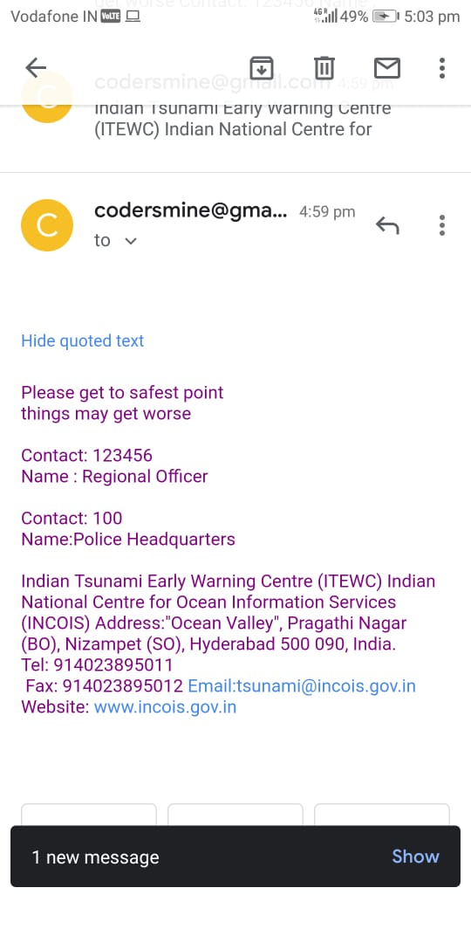
Real-time data display
Using JavaScript, the coordinates (latitudes, longitudes) are picked from firebase and plotted on real-time map as precise pin-points.
1
We use strings to append the present data along with the previous data so that we don’t lost any of the past values.
2

Slide 6
Mobile phone Application
During Tsunami, internet connectivity is usually poor. Therefore, broadcasting a message on a radio frequency would be the best option to alert those who don’t have the availability of a smartphone with them.
Data from ML model
Web connectivity==false
Tsunami Predicted
Web connectivity==true
FM Radio frequency app based solution
Web based solution (Areas of danger on map)

Slide 7
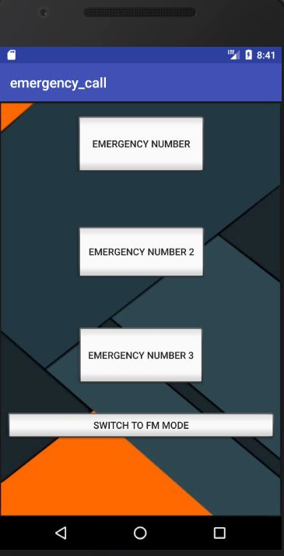
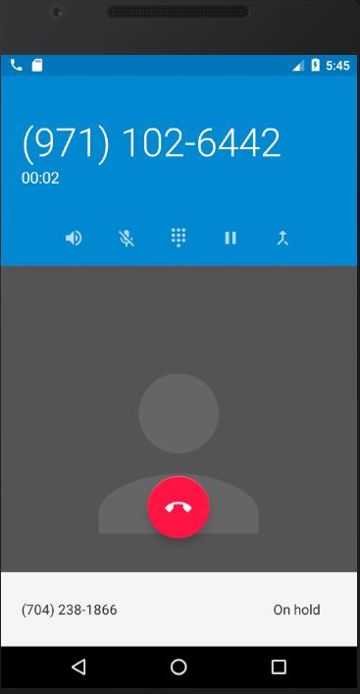
Mobile App features
The app will have a predefined frequency assigned by some FM Channel for Tsunami broadcasting purposes as the helpline for those who can access radio FM in some way.
In the mobile application, the notifications will be sent through various modes of communication like email, SMS, GTS, call, FM broadcast.

Slide 8
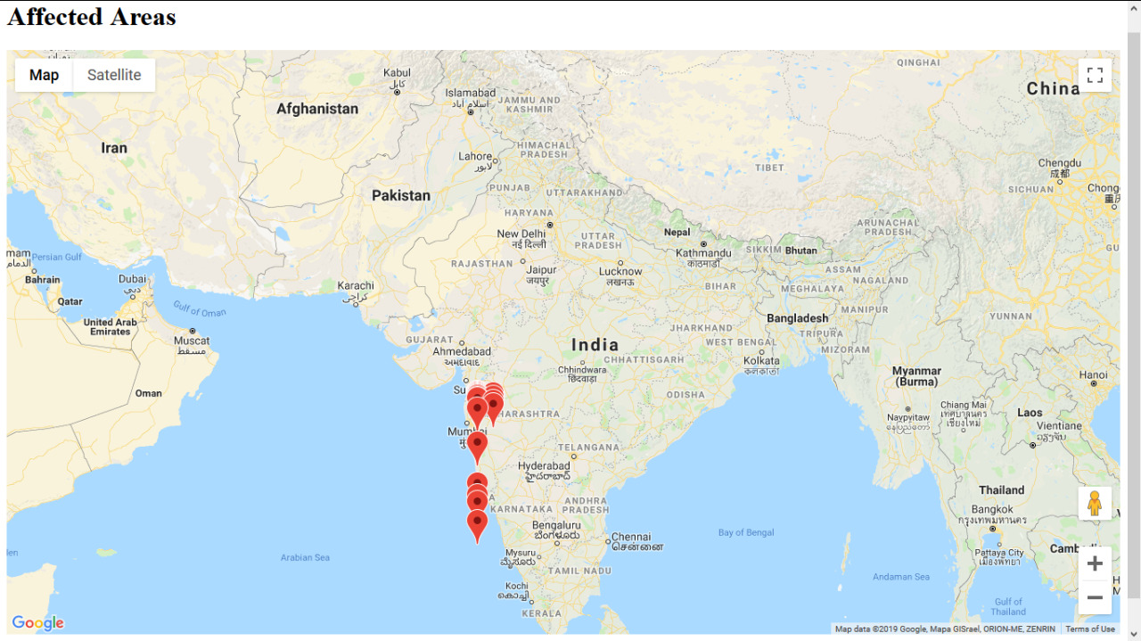
Tsunami Prediction
The app has now predicted the affected places due to Tsunami
Using data science, various alert emails will be sent at once to all the relief centers for the initialization of rescue operations in those places.
The users will be notified about the arrival of Tsunami along with the affected places marked on the map precisely.

Slide 9
Market scope
The alert mechanism and system is cost effective.
01
Basic and effective algorithms.
02
Reduced processing time with efficient working.
03
Accurate image analysis.
04
We may get false positive results but the chances of getting false negative results is very low.
05

